Slide 1
Universal Learning Systems EYDP Project Kick-off
Dr. Alan Bruce Imelda Graham
12 December 2022

Slide 2
Who is ULS?
International consultancy
Founded 1996
Mission: ’Providing solutions in a time of change’
Profile:
Disability and rehabilitation
Developing countries
Labor market analysis
Training and education
Strategic change management consultancy
EU policy

Slide 3
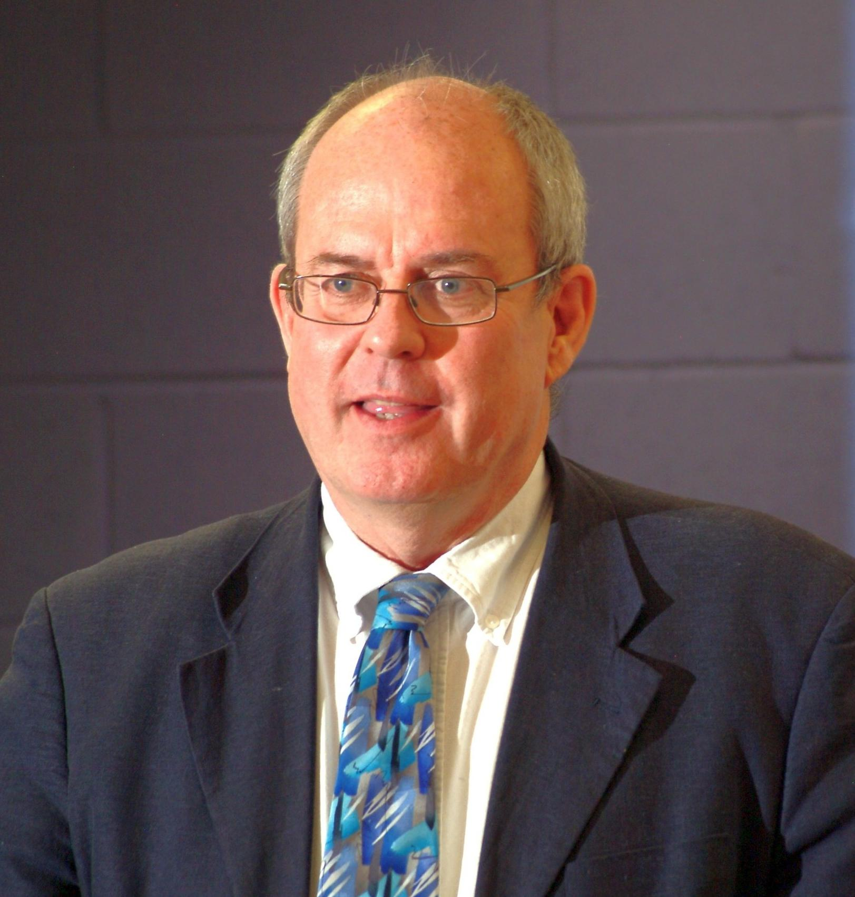
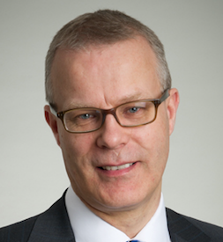
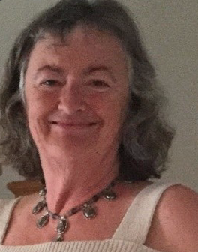
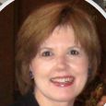
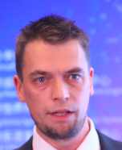
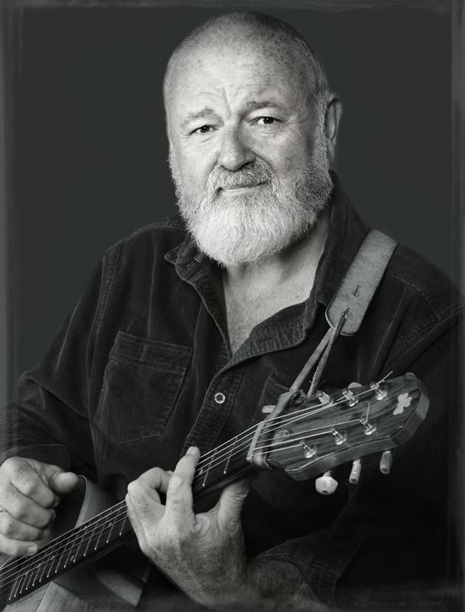
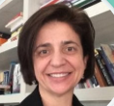
ULS International
Andy Galloway
(Ireland)
Imelda Graham
(Ireland)
Teemu Patala
(Helsinki, Finland)
Luci Ferraz
(Sao Paulo, Brazil)
Dr. Alan Bruce
(Ireland;
Barcelona, Spain)
Michelle Marmé
(Chicago, US)
Terry Datson
(Cork, Ireland)

Slide 4
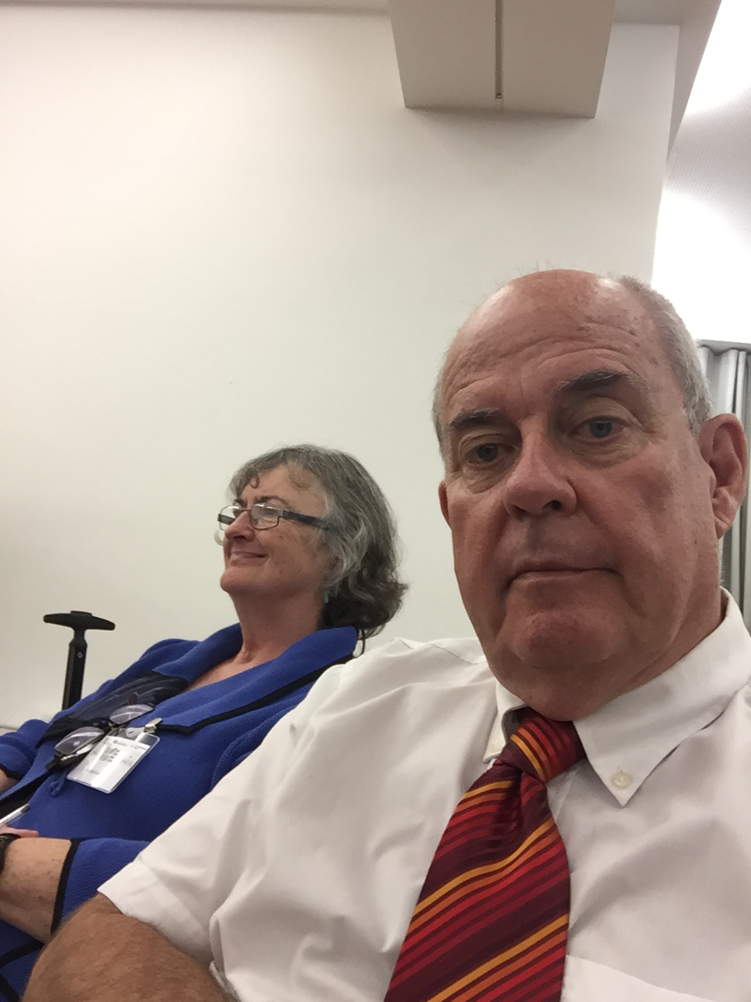
Introducing Ourselves

Slide 5
Dr Alan Bruce

Slide 6
Imelda Graham

Slide 7
ULS Core Areas
Research and evaluation
Learning design, course development
Strategic Planning/Continuous Improvement
Migration and interculturalism
Security and conflict transformation
Transnational project innovation
Diversity Management
E-learning
Schools: change and innovation
Social inclusion
Employer based training
Capacity development in NGOs
Universal Design for Learning
EU Expert Evaluation

Slide 8
ULS LOCATIONS
Ireland: Cork (head office)
United States: Chicago
Czech Republic: Prague
Finland: Helsinki
Brazil: Sao Paulo
Spain: Barcelona
Specialized: Greece, Ecuador, China, Cyprus, Netherlands, Palestine

Slide 9
ULS Key EU Projects
ICPD (1997-98): Horizon
CODE (1998-2000): Horizon
WICCA (1998-99): NOW
VOLTAIRE (1999-2000): Adapt
BOOST (1998-99): Employment
TechnoArt (2001-03): Leonardo da Vinci
Co-Guide (2003-05): Leonardo da Vinci
TRED (2003-06): Equal
CATIT (2005-08): Leonardo da Vinci
Educonlinux (2007-09): Minerva
SPEAK (2008-09): Comenius
Sink or Swim (2008-10): Grundtvig
Creanova (2008-11): LLP Transversal Research
UEmploy (2010-12): Leonardo da Vinci
FIESTA (2011-14): Comenius
LANGO (2012-14): KA2
NELLIP (2012-15): KA2
TRANSit (2012-15): Comenius Multilateral
CAREM (2013-15)
UDLnet (2014-16)
ADOLL (2014-17)
E-STEP (2014-16)
ODS (2012-14)
APPs (2017-20)
Added Value (2018-21)
SENDING (2018-21)
TEFL-ePAL (2018-21)
CARE (2021-24)
IHES (2022-25)

Slide 10
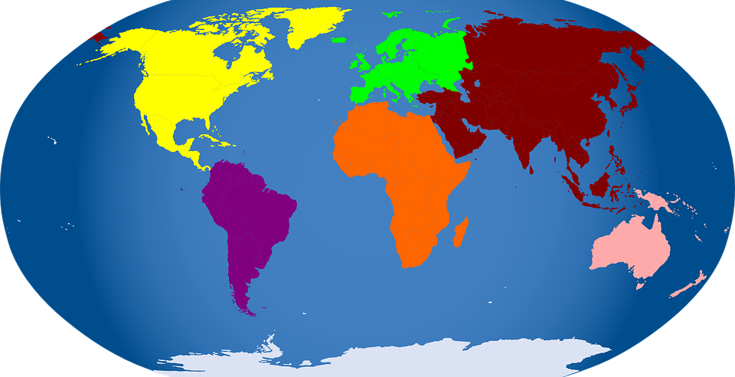
Innovative learning - University collaboration
NUI Cork (1999- present)
NUI Galway (2001- present)
University of Edinburgh (2009 – 14)
Queens University Belfast (2011- present)
NHL Leeuwarden (2013 – present)
Open University of Catalonia, Barcelona (2013-present)
University of Beijing (2017 – present)
University of Illinois (1997-2002)
University of Wisconsin (2003- present)
University of Memphis (2005- present)
UNAE Ecuador (2017 – presen)
Université Catholique de Madagascar, Antanarivo (2021-
CCNU Wuhan (2006- present)
Open University of Hong Kong (2015 – present)
Hamdan bin Mohamed University, Dubai (2015)
NCUE Taiwan (2016 – present Professorship)
Charles Sturt University, Austrtalia (2015- present)
Al Quds Open University,
Palestine

Slide 11
Milestones
Company based learning: Waterford Crystal
Academic innovation: Limerick Institute of Technology
Pioneering learning disability: University of Illinois
Adult education: Cork and Galway
Strategic planning: disability, rehabilitation, drugs sectors
Diversity and equality
Strategic evaluation
Conflict Resolution programs: Bosnia, Kosovo, Cyprus, Euzkadi, N. Ireland, Palestine
Migration and inclusion
Distance and e-learning
Innovative employer based training
Refugee education
E-Learning national policy research and development: Jordan and Saudi Arabia

Slide 12
EDEN Symposium, UOC, Barcelona 2018

Slide 13
Future focus
Enhanced e-learning programs/AI
Research and development on innovation
Capacity development in NGO sector
Transformative conflict resolution
Professional competence and quality
Sustainable employment innovation
Academic linkage and course development
Early childhood innovation in training
UDL and disability integration focus

Slide 14
ULS contribution to IHES
Dissemination
Evaluation
Global Learning focus
Additional inputs to project management
Networking
Rehabilitation expertise
Robust publication/presentation schedule
Intercultural focus

Slide 15
NCUE Taiwan, Professorship 2016

Slide 16
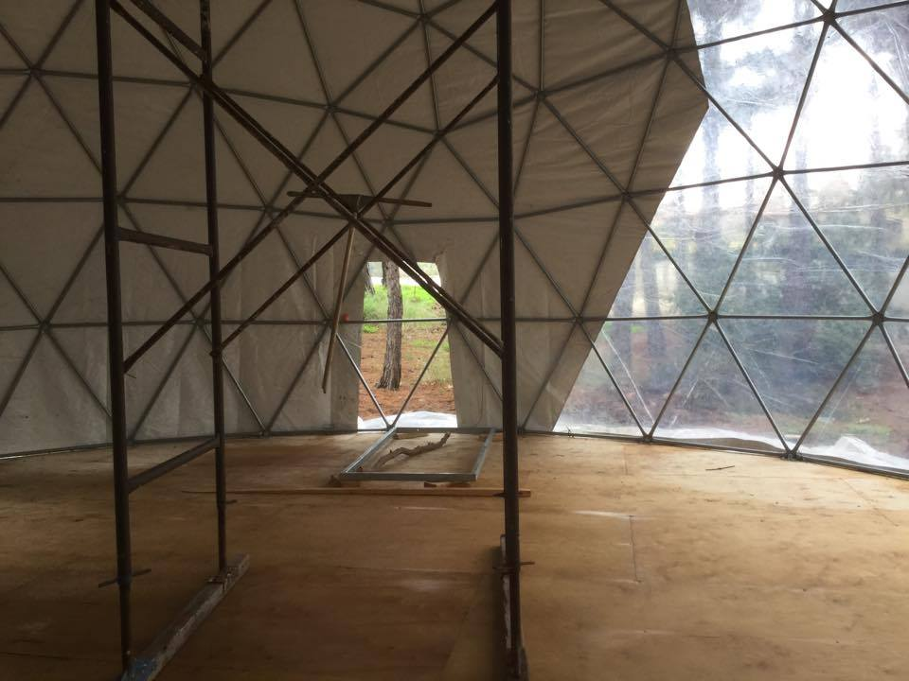
Education: Greece & Lesvos 2016

Slide 17
TEFL-ePAL launch, Anadolu University 2019

Slide 18
EASME Report Expert Inputs: Brussels 2019

Slide 19
Universal Learning Systems
www.ulsystems.com
www.changelearning.eu
abruce@ulsystems.com
imeldag@gmail.com

